Slide 1
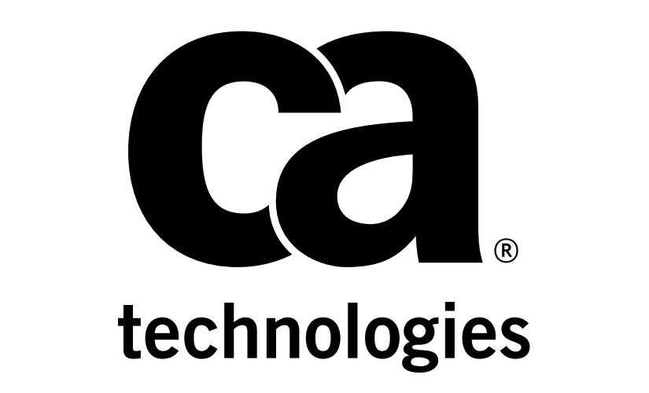

Slide 2

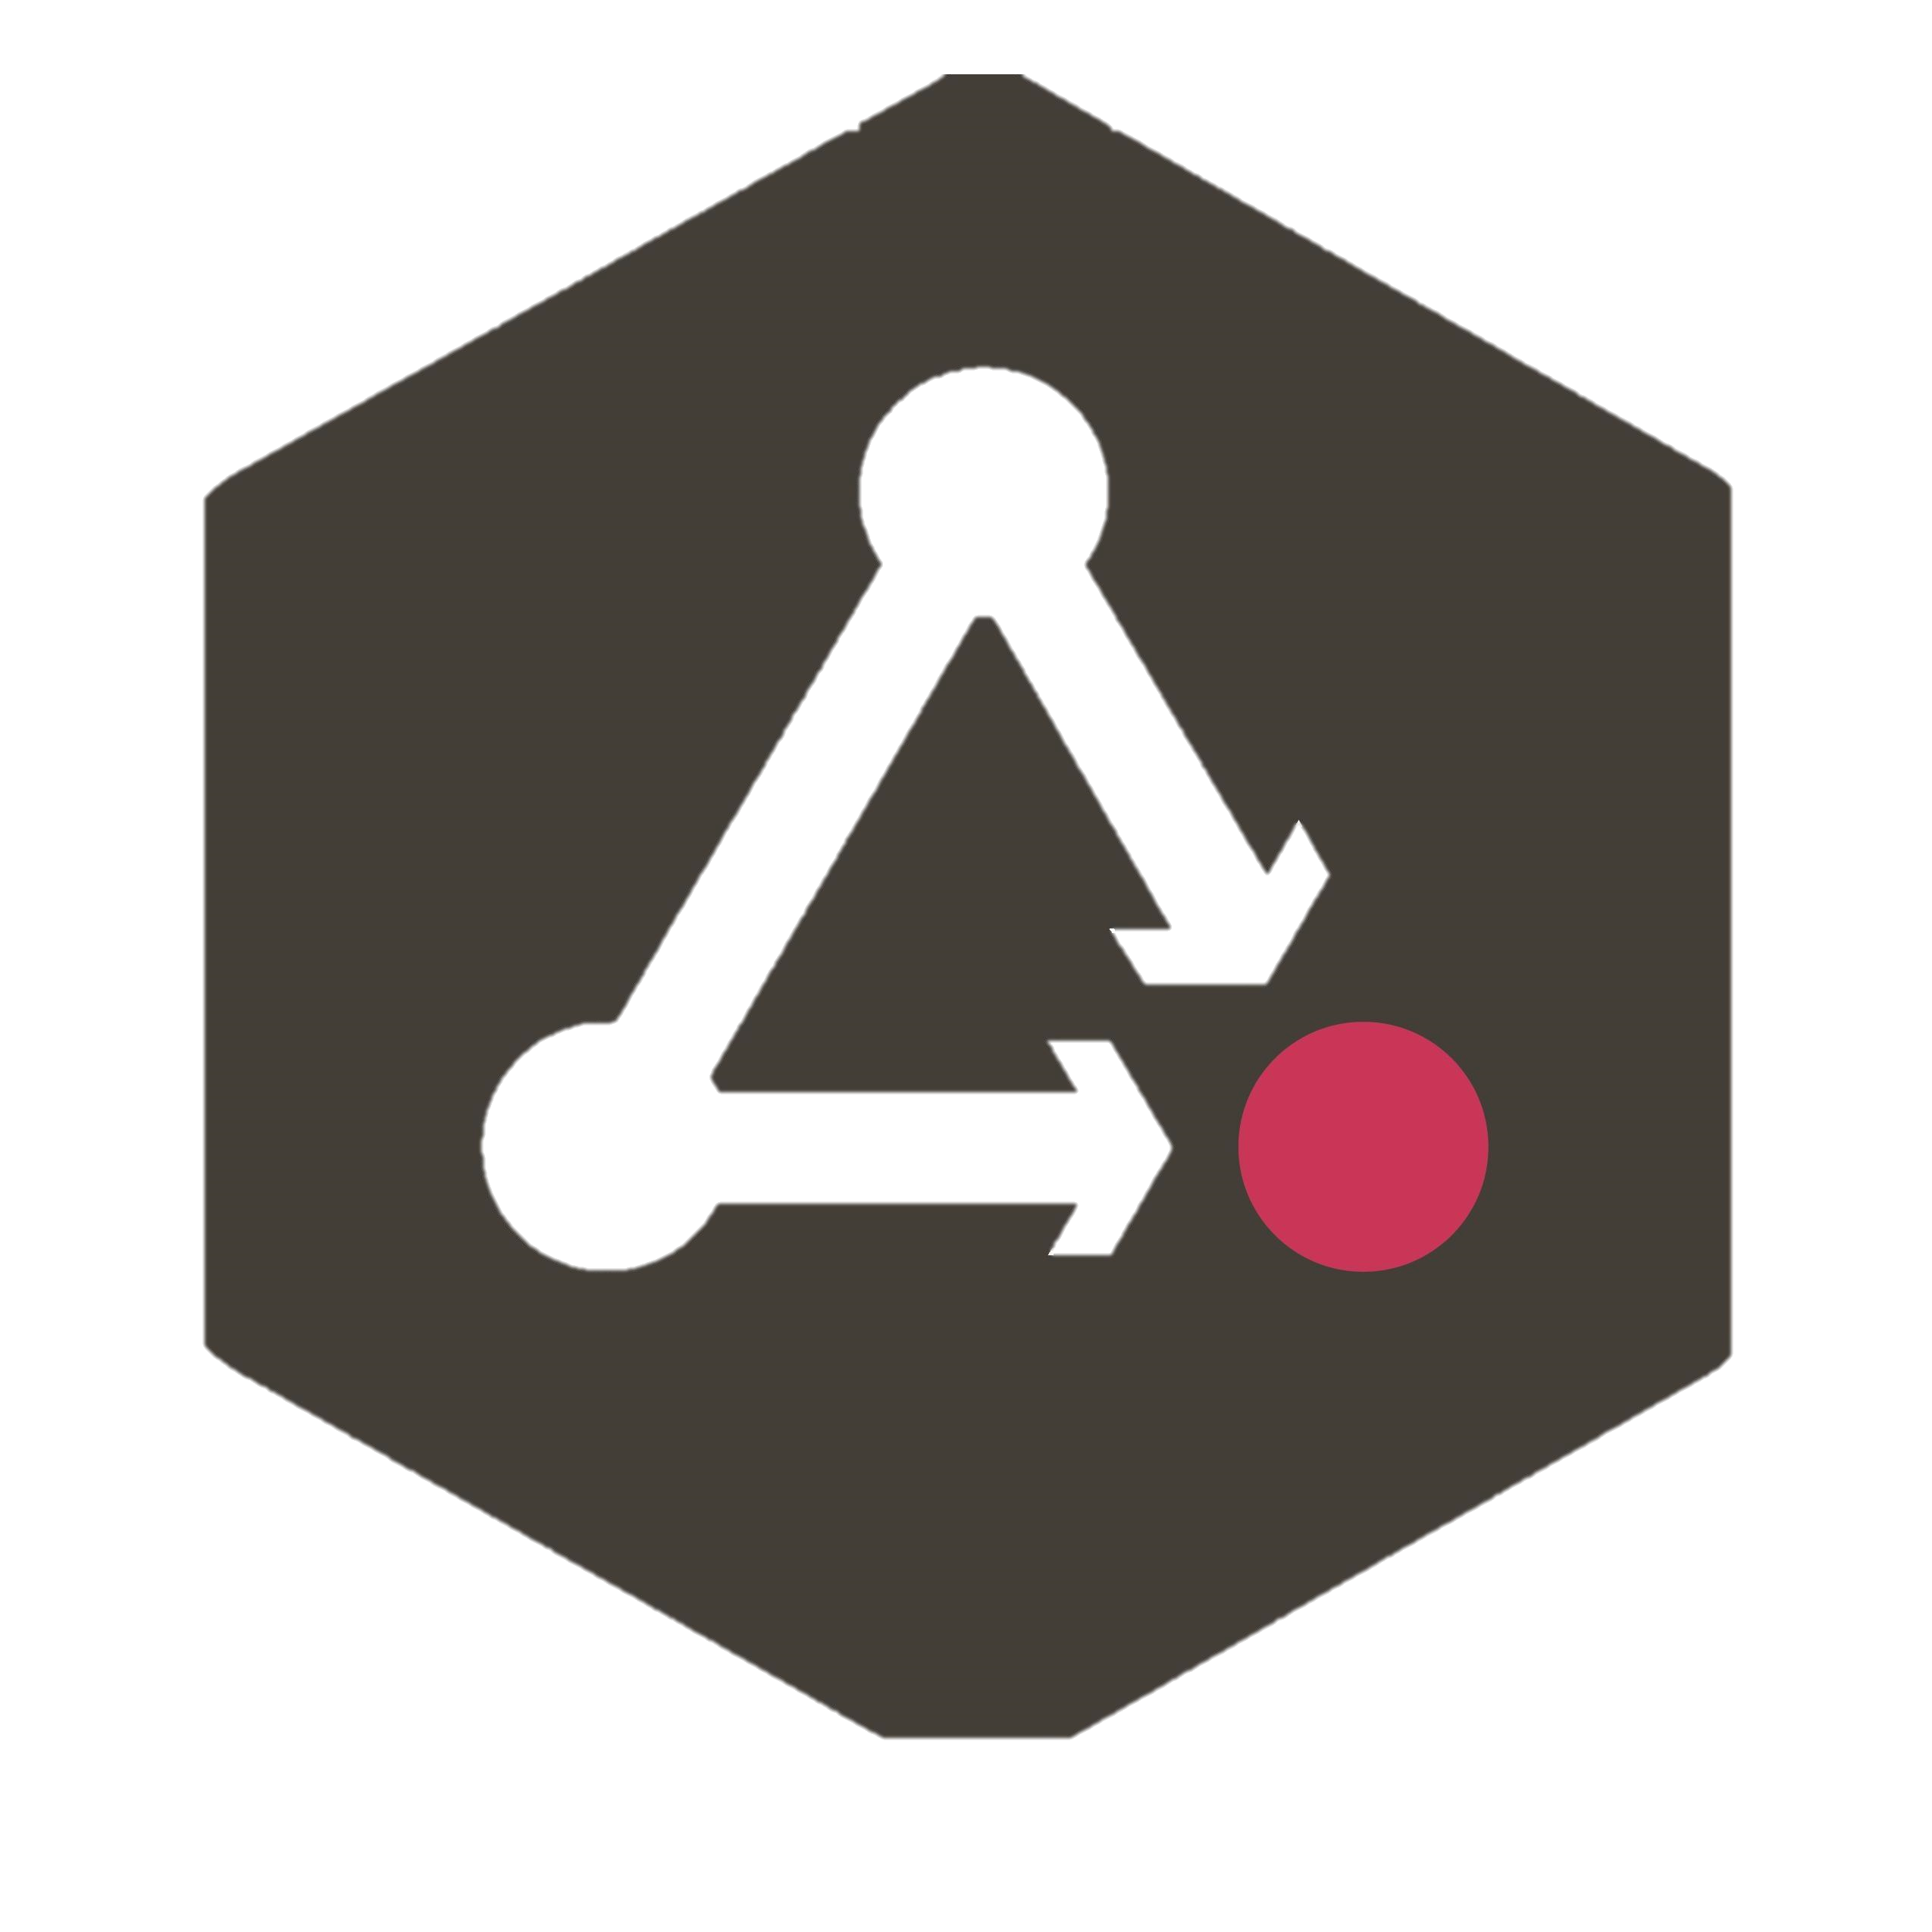
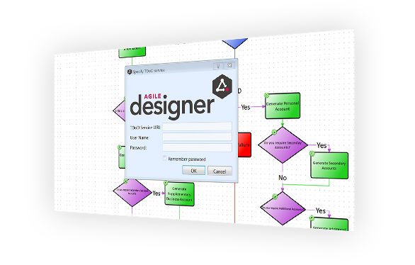

Agile Requirements Designer
Copyright © 2018 CA Technologies. All rights reserved.

Slide 3
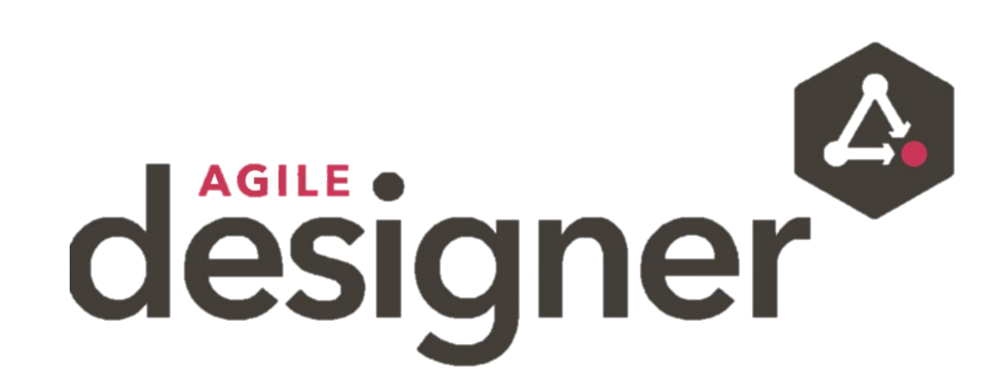
ARD?
A piece of software that helps build software. It an end-to-end requirements gathering, test automation and test case design tool that drastically reduces manual testing effort and enables organizations to deliver quality software to market earlier and at less cost.
Copyright © 2018 CA Technologies. All rights reserved.

Slide 4
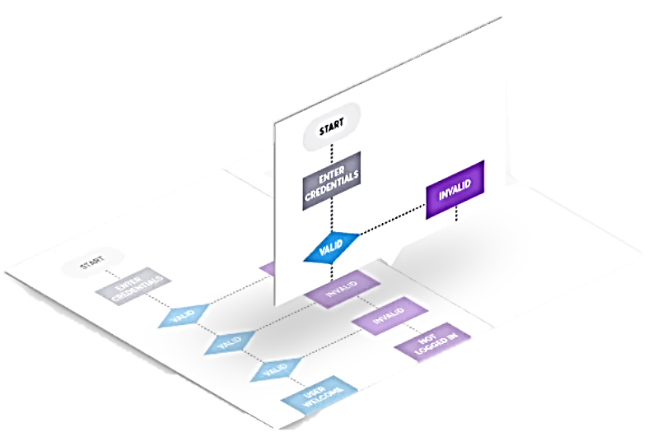
Requirements Engineering
Model requirements as an active flowchart, tackles the issue of ambiguous requirements.
Accommodates change more efficiently, removes the tedious and time consuming iterations that would take place between testers and developers.
Automatically generate optimal test cases and test automation scripts – right from your requirements.
Copyright © 2018 CA Technologies. All rights reserved.

Slide 5
Test Cases
Test cases are steps to show if a particular feature or functionality is working correctly or satisfying requirements.
Test case optimization to provide various levels of test coverage.
All Nodes
All possible outcomes
All Edges
All In/Out Edges
All Pairs
Copyright © 2018 CA Technologies. All rights reserved.

Slide 6
Test Automation
ARD builds/generates tests for you so you don’t have to worry about it.
Automation scripts – a script that pretends to be you (generated from requirements) and as a tester you have nothing else to do other than run those scripts.
70% of testing is still being done manually, this can slow you down dramatically and can wear out your testers.
Manual testing means increase in human error. Increasing errors while overall productivity decreases. ARD addresses these significant challenges.
Copyright © 2018 CA Technologies. All rights reserved.

Slide 7
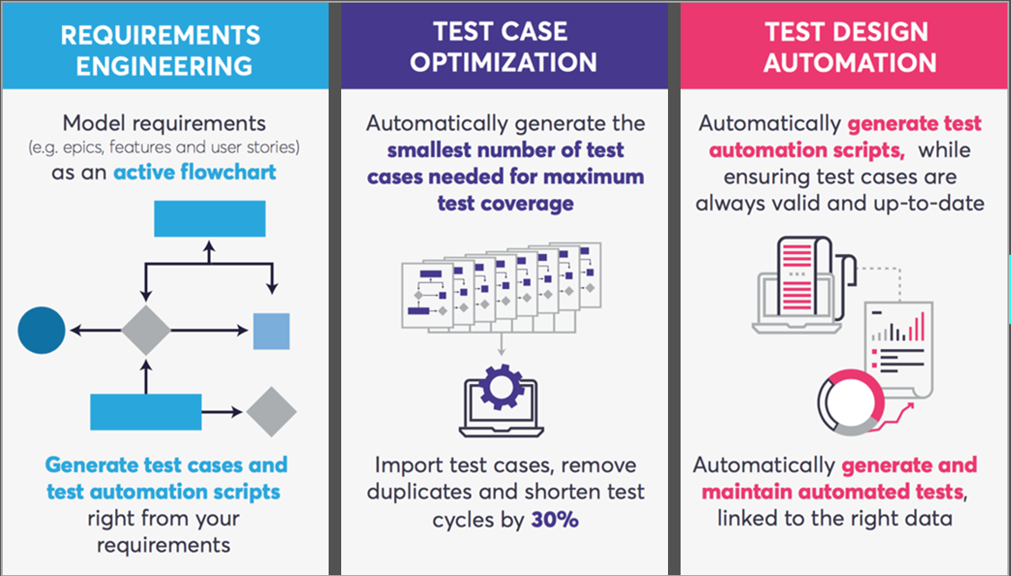
Summary
Copyright © 2018 CA Technologies. All rights reserved.

